Slide 1
Chapter 3
Introduction to Optimization Modeling
Winston/Albright
Practical Management Science, 6e
© 2019 Cengage. May not be scanned, copied or duplicated, or posted to a publicly accessible website, in whole or in part.

Slide 2
A two-variable product mix model
This is a type of problem frequently encountered in business where a company must decide its product mix – how much of each of its potential products to produce – to maximize its net profit.
You will see how to model this problem algebraically and then how to model it in Excel.
You will also see how to find its optimal solution with Solver. Next, because it contains only two decision variables, you will see how it can be solved graphically.
The final step is then to ask a number of what-if questions about the completed model.
This model is presented in Example 3.1
Notes:
Example 3.1 :
The PC Tech company assembles and then tests two models of computers, Basic and XP. For the coming month, the company wants to decide how many of each model to assemble and then test. No computers are in inventory from the previous month, and because these models are going to be changed after this month, the company doesn’t want to hold any inventory after this month. It believes the most it can sell this month are 600 Basics and 1200 XPs. Each Basic sells for $300 and each XP sells for $450. The cost of component parts for a Basic is $150; for an XP it is $225. Labor is required for assembly and testing. There are at most 10,000 assembly hours and 3000 testing hours available. Each labor hour for assembling costs $11 and each labor hour for testing costs $15. Each Basic requires five hours for assembling and one hour for testing, and each XP requires six hours for assembling and two hours for testing. PC Tech wants to know how many of each model it should produce (assemble and test) to maximize its net profit, but it cannot use more labor hours than are available, and it does not want to produce more than it can sell.

Slide 3
An algebraic model (1 of 5)
In the traditional algebraic solution method, you first identify the decision variables.
In this small problem, they are the numbers of computers to produce. We label these x₁ and x₂, although any other labels would do.
The next step is to write expressions for the total net profit and the constraints in terms of the xs.
Finally, because only nonnegative amounts can be produced, explicit constraints are added to ensure that the xs are nonnegative.

Slide 4
An algebraic model (2 of 5)
Objective function: max profit
Profit margin for basic:
$300 - $150 - $11*5 - $15*1 = $80
Profit margin for XP:
$450 - $225 - $11x6 - $15x2 = $129
Profit: $80*x1 + $129*x2

Slide 5
An algebraic model (3 of 5)
Constraints:
Limited assembling hours: used <= available.
5*x1 + 6*x2 <= 10,000
Limited testing hours: used <= available.
x1 + 2*x2 <= 3,000
Demand: production <= demand.
x1 <= 600; x2 <= 1200
Non-negativity constraint.
x1, x2 >= 0.

Slide 6
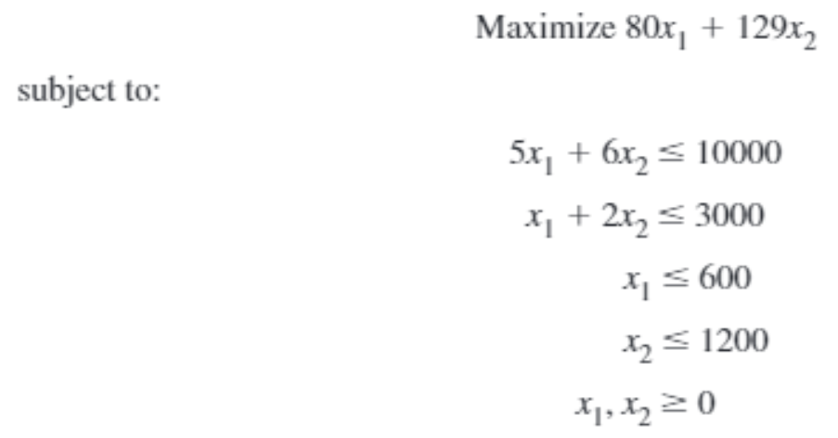
An algebraic model (4 of 5)

Slide 7
An algebraic model (5 of 5)
For many years, all LP problems were modeled this way in textbooks. In fact, many commercial LP computer packages are still written to accept LP problems in essentially this format.
Since around 1990, however, a more intuitive method of expressing LP problems has emerged. This method takes advantage of the power and flexibility of spreadsheets.
With the addition of Solver, spreadsheets have the ability to solve - that is, optimize - LP problems as well.

Slide 8
A graphical solution (1 of 3)
When there are only two decision variables in an LP model, as there are in this product mix model, you can solve the problem graphically.
Although this graphical solution approach is not practical in most realistic optimization models – where there are many more than two decision variables – the graphical procedure illustrated here still yields important insights for general LP models.

Slide 9
A graphical solution (2 of 3)
In general, if the two decision variables are labeled x₁ and x₂, then the steps of the method are to express the constraints and the objective in terms of x₁ and x₂, graph the constraints to find the feasible region, and then move the objective through the feasible region until it is optimized.

Slide 10
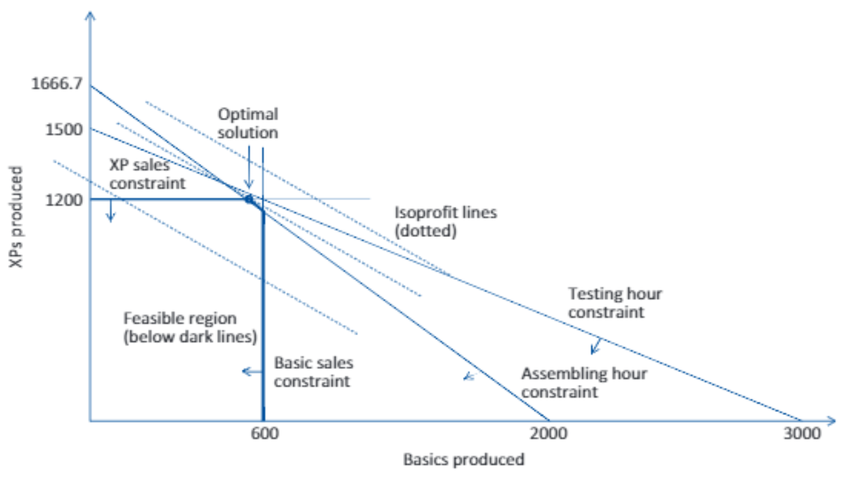
A graphical solution (3 of 3)

Slide 11
Graphical solutions in general
The graphical procedure illustrated here can be used only for the simplest of LP models, those with two decision variables. However, the type of behavior pictured above generalizes to all LP problems.
In general, all feasible regions are the multidimensional versions of polygons.
They are bounded by straight lines (hyperplanes) that intersect at several corner points.
Because there are only a finite number of corner points, it suffices to search among this finite set, not over the entire feasible region.

Slide 12
A spreadsheet model (1 of 6)
There are many ways to develop an LP spreadsheet model.
Everyone has his or her own preferences for arranging the data in the various cells. We do not provide exact prescriptions, but we do present enough examples to help you develop good habits.
The common elements in all LP spreadsheet models are the inputs, changing cells, objective cell, and constraints.

Slide 13
A spreadsheet model (2 of 6)
Inputs. All numerical inputs – that is, all numeric data given in the statement of the problem – should appear somewhere in the spreadsheet.
Our convention is to color all of the input cells blue.
We also try to put most of the inputs in the upper left section of the spreadsheet.
However, we sometimes violate this latter convention when certain inputs fit more naturally somewhere else.

Slide 14
A spreadsheet model (3 of 6)
Decision variable cells. Instead of using variable names, such as x₁, spreadsheet models use a set of designated cells for the decision variables.
The values in these changing variable cells can be changed to optimize the objective.
The values in these cells must be allowed to vary freely, so there should not be any formulas in the changing variable cells.
To designate them clearly, our convention is to color them red.

Slide 15
A spreadsheet model (4 of 6)
Objective cell. One cell, called the objective cell, contains the value of the objective.
Solver systematically varies the values in the changing cells to optimize the value in the objective cell.
This cell must be linked, either directly or indirectly, to the changing cells by formulas.
Our convention is to color the objective cell gray.

Slide 16
A spreadsheet model (5 of 6)
Constraints. Excel does not show the constraints directly on the spreadsheet. Instead, they are specified in a Solver dialog box. For example, a set of related constraints might be specified by
B16:C16<=B18:C18
We will always assign range names to the ranges that appear in the constraints. Then a typical constraint might be specified as
Number_to_produce<=Maximum_sales

Slide 17
A spreadsheet model (6 of 6)
Nonnegativity. Normally, the decision variables – that is, the values in the changing cells – must be nonnegative.
These constraints do not need to be written explicitly; you simply check an option in the Solver dialog box to indicate that the changing cells should be nonnegative.
Note, however, that if you want to constrain any other cells to be nonnegative, you must specify these constraints explicitly.

Slide 18
Overview of the solution process (1 of 2)
The complete solution of a problem involves three stages.
In the model development stage you enter all of the inputs, trial values for the changing cells, and formulas relating these in a spreadsheet.
This stage is the most crucial because it is here that all of the ingredients of the model are included and related appropriately.

Slide 19
Overview of the solution process (2 of 2)
After the model is developed, you can proceed to the second stage - invoking Solver.
At this point, you formally designate the objective cell, the changing cells, the constraints, and selected options, and you tell Solver to find the optimal solution.
If the first stage has been done correctly, the second stage is usually very straightforward.
The third stage is sensitivity analysis. Here you see how the optimal solution changes (if at all) as selected inputs are varied.
This often provides important insights about the behavior of the model.

Slide 20
Where do numbers come from?
Textbooks typically state a problem, including a number of input values, and proceed directly to a solution—without saying where these input values might come from. However, finding the correct input values can sometimes be the most difficult step in a real-world situation.

Slide 21
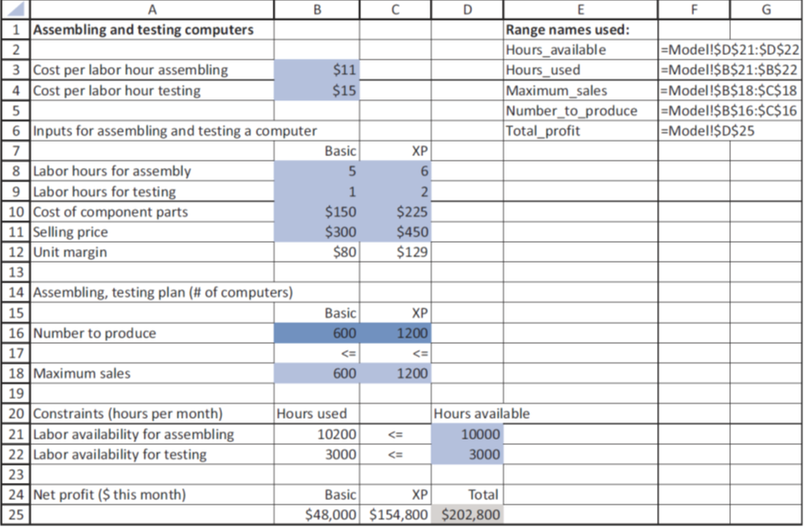
Developing the spreadsheet model (1 of 5)
See figure 3.3

Slide 22
Developing the spreadsheet model (2 of 5)
To develop this model, use the following steps.
1. Inputs. Enter all of the inputs from the statement of the problem in the light blue cells as shown.
2. Range names. Create the range names shown in columns E and F. Our convention is to enter enough range names, but not to go overboard.
3. Unit margins. Enter the formula =B11-B8*$B$3-B9*$B$4-B10 in cell B12 and copy it to cell C12.

Slide 23
Developing the spreadsheet model (3 of 5)
4. Decision variable cells. Enter any two values for the decision variable cells in the Number_to_produce range. Any trial values can be used initially; Solver eventually finds the optimal values.
5. Labor hours used. To operationalize the labor availability constraints, you must calculate the amounts used by the production plan. To do this, enter the formula =SUMPRODUCT(B8:C8,Number_to_produce) in cell B21 for assembling and copy it to cell B22 for testing. This formula is a shortcut for the following fully written out formula: =B8*B16+C8*C16

Slide 24
Developing the spreadsheet model (4 of 5)
5. cont. The SUMPRODUCT function is very useful in spreadsheet models, especially LP models, and you will see it often. Here, it multiplies the number of hours per computer by the number of computers for each model and then sums these products over the two models. When there are only two products in the sum, as in this example, the SUMPRODUCT formula is not really any simpler than the written-out formula. However, imagine that there are 50 computer models. Then the SUMPRODUCT formula is much simpler to enter (and read). For this reason, you should use it whenever possible. Note that each range in this function, B8:C8 and Number_to_produce, is a one-row, two-column range. It is important in the SUMPRODUCT function that the two ranges be exactly the same size and shape.

Slide 25
Developing the spreadsheet model (5 of 5)
6. Net profits. Enter the formula =B12*B16 in cell B25, copy it to cell C25, and sum these to get the total net profit in cell D25. This latter cell is the objective to maximize. Note that if you didn’t care about the net profits for the two individual models, you could calculate the total net profit with the Formula =SUMPRODUCT(B12:C12,Number_to_produce) As you see, the SUMPRODUCT function appears once again. It and the SUM function are the most used functions in LP models.

Slide 26
Experimenting with Possible Solutions (1 of 2)
The next step is to specify the decision variable cells, the objective cell, and the constraints in a Solver dialog box and then instruct Solver to find the optimal solution. However, before you do this, it is instructive to try a few guesses in the decision variable cells. There are two reasons for doing so.
First, by entering different sets of values in the decision variable cells, you can confirm that the formulas in the other cells are working correctly. Second, this experimentation can help you to develop a better understanding of the model.

Slide 27
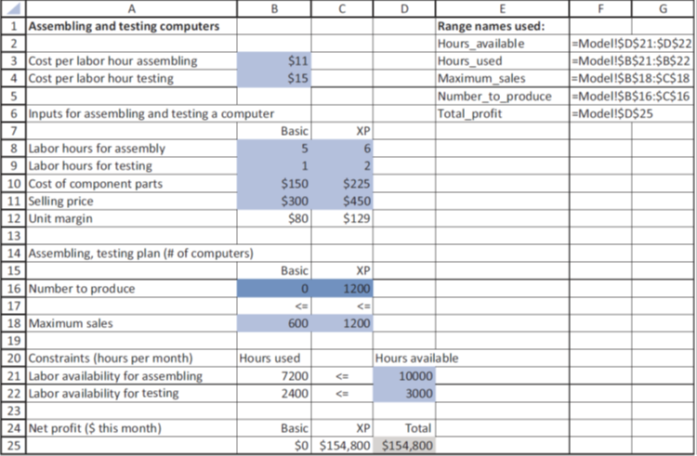
Experimenting with Possible Solutions (2 of 2)
For example, the profit margin for XPs is much larger than for Basics, so you might suspect that the company will produce only XPs. The most it can produce is 1200 (maximum sales), and this uses fewer labor hours than are available. This solution appears in Figure 3.4.

Slide 28
Using Solver (1 of 2)
Load the Solver Add-in in Excel (For Windows)
In Excel 2010 and later, go to File > Options. ...
Click Add-Ins, and then in the Manage box, select Excel Add-ins.
Click Go.
In the Add-Ins available box, select the Solver Add-in check box, and then click OK. ...
After you load the Solver Add-in, the Solver command is available in the Analysis group on the Data tab.

Slide 29
Using Solver (1 of 2)
Load the Solver Add-in in Excel (For Mac)
On the Tools menu, select Excel Add-Ins.
In the Add-Ins available box, select the Solver Add-In check box, and then click OK.
If Solver Add-in is not listed in the Add-Ins available box, click Browse to locate the add-in.
If you get a prompt that the Solver add-in is not currently installed on your computer, click Yes in the dialog box to install it.
After you load the Solver add-in, the Solver button is available on the Data tab.

Slide 30
Using Solver (1 of 2)
To invoke Excel’s Solver, select Solver from the Data ribbon.
The Solver dialog boxes on the next slide should be completed as shown.
Three important sections:
The objective cell
The changing variable cells
Constraints
For the product mix problem, we can fill these in by typing cell references or we can point, click and drag the appropriate ranges in the usual way.

Slide 31
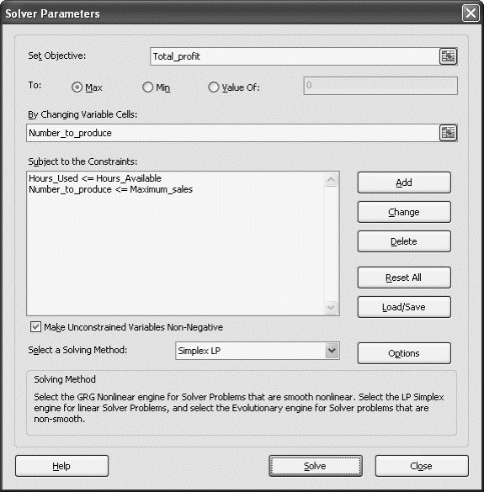
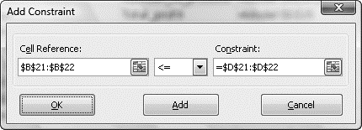
Using Solver (2 of 2)
This is a Solver dialog box for Excel 2016. It is more convenient than similar dialog boxes in previous versions because the typical settings now all appear in the single dialog box.

Slide 32
Typical solutions (1 of 2)
The solution for the example above is typical of solutions to optimization models in the following sense.
Of all the inequality constraints, some are satisfied exactly and others are not.
An inequality constraint is binding if the solution makes it an equality. Otherwise, it is nonbinding.
The positive difference between the two sides of the constraint is called the slack.

Slide 33
Typical solutions (2 of 2)
In a typical solution, you should pay attention to two aspects:
First, which of the changing variable cells are positive (as opposed to 0).
Generically, these are the “activities” that are done at a positive level.
In a product mix model, they are the products included in the optimal mix.
Second, you should check which of the constraints are binding. Again, these represent the bottlenecks that keep the objective from improving.

Slide 34
Next: Sensitivity Analysis
Having found the optimal solution does not mean the analysis is complete.
It is always useful to perform a sensitivity analysis to see how the optimal solution changes as one or more inputs vary.

